Slide 1

Curbing Employee Attrition UNLOCKING INSIGHTS TO RETAIN TOP TALENT
André Oliveira – 2022156 ● Diogo Fernandes – 20220507 ● Diogo Ribeiro Santos – 20222152 ● Gonçalo Matos - 20221194

Slide 2
Executive Summary (1/3)
Our company ranks higher than the world average on employee attrition, wasting resources with turnover
The company ranks 3 pp above the world average. This translates in an estimated annual cost of 20.7 million euros in the substitution process, plus indirect costs like employee demoralization and client dissatisfaction.
To predict attrition, suggest strategies to lower its rate and, consequently, save resources, our team created a model, it can identify which employees are about to leave, which are the contributing factors and what makes an employee keep working on the company.
To characterize and understand the reasons of employees that are about to leave, we classified all employees in groups with three distinct profiles.
The predictive model can correctly identify 69% of employees in risk of leaving the company
The factors contributing to increased attrition, in order of importance, include working overtime hours, frequent business travel, frequent company changes, lack of career progression, and having a long commute.
The factors contributing to decrease attrition, in order of importance, include having a stable career (working for the company on the same role for longer), feeling involved on the job and be satisfied in the work, environment and relationship levels.

Slide 3
Executive Summary (2/3)
Current employees can be classified into three distinct groups, one of them in need of intervention
Where’s the door? group - Requires immediate measures. Consists of 219 employees, all of them leaving the company. High proportions of overtime and business traveling. Low job and environment satisfaction, low job involvement and live further away from the company.
Young go getters group – No action required. Consists of 817 employees, none leaving the company. Opposite of the latter group in terms of attrition predictors.
Old but gold group – Requires further investigation. Consists of 435 employees, only 19 (4%) leaving the company. Similar to the latter in terms of attrition predictors. Most of the elements with attrition are retirement cases but others are lagging in career progression.
We can take immediate measures to retain current employees and forward-looking measures to gather data to make better decisions in the future
It’s important to increase the frequency of training sessions to reduce overtime, since less trained employees are more likely to do extra hours. It’s also important to gather more data to identify the causes and to know how many hours each worker is putting in, to tailor the solutions to the problems and improve the current model.

Slide 4
Executive Summary (3/3)
We must reduce unnecessary business traveling, set travel policies to help offset its effects and increase employee rotation. Additionally, we need to gather more data to understand its frequency and if there are any notable thresholds.
We need to improve employee performance evaluation and create personalized development plans to avoid career stagnation.
To mitigate long commute effects, we can offer commuter benefits, like subsidizing a public transportation pass, promote remote work and flexible schedules.
To avoid job hopping we can offer industry competitive compensation and benefits while providing opportunities for career and professional growth.
Work involvement, job, environment and relationship satisfaction offset effects of negative factors
Total working years and number of years in the current role are the paramount factors to keep attrition low, indicating that employees with stable careers have a lesser probability of leaving the company.
Fostering job involvement, job, environment and relationship satisfaction are the key to create and maintain a company where employees wish to stay and develop their skills and careers.

Slide 5
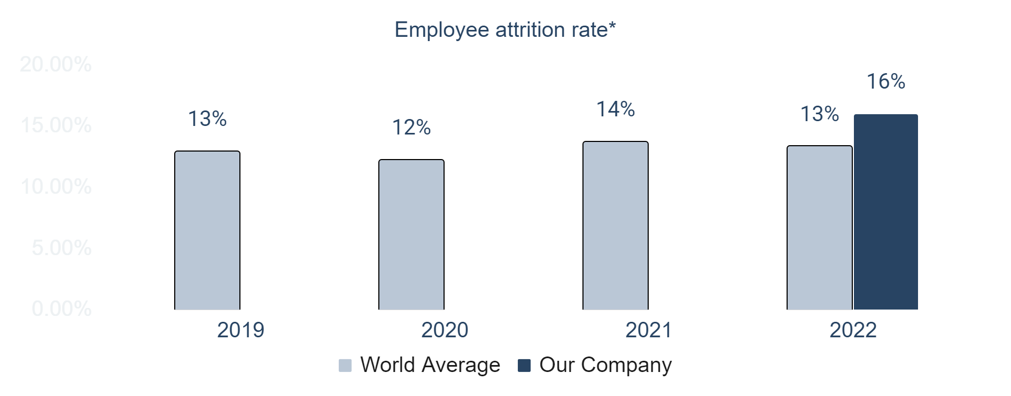
8% of total annual labor budget spent with turnover
1
Employee attrition is defined as the natural process by which employees leave the workforce. It can be voluntarily (resignation or retirement) or involuntary (termination).
Attrition Costs
Annual Labour Costs
Hiring and Training
Indirect Costs
- Time to full productivity
- Demoralization of employees
- Loss of Knowledge
8%
Annual Labour Costs²
20.7M
252M
14K
162K
cost range per worker
1. Source: https://www.statista.com/statistics/934377/professional-services-worldwide-employee-attrition-by-region/ (last data access at 10/10/23), 2. Ongori, H. (2007)
Notes:
Situation : As you know… a level of attrition and turnover is inevitable in the workplace and happens in companies all over the world.
Complication: In our company the rate is higher. This can be a signal that somethings might not be right inside the company. As a direct consequence there’s a lot of money spent in the process.

Slide 6
Project Goals : Predict Attrition, its determinant factors and employee subgroups profiling
How can we lower the attrition rate and save money on replacing employees?
Gathered a dataset with variables of interest
Predictive Model
Clustering: Group Profiling
- Identify what variables make an employee stay and leave the company
- Predict which employees potentially will quit
- Enables preventive actions to increase employee retention
- Characterize each employee group
- Distinguish between normal causes of attrition
(retiring) and factors that are making people leave and seek better options
- Enables addressing current issues in a tailored fashion

Slide 7
Our model can correctly identify 69% of employees with attrition
Statistical Description
Normalization & Outliers
Exploratory
Data Analysis
Logistic Regression
Simplicity & Interpretability
Uni and Multivariate Analysis
From the 32 employees with attrition the model identified 22 (recall – 69%)
From the 47 employees the model identified with attrition, 22 have it (precision - 47%)
In addition to precision and recall, there’s a third metric (F1 score) that considers both aspects.
The F1 score is 56%, indicating a good overall performance in balancing the identification of employees with attrition while minimizing false positives
Principal Component Analysis
Multiple correspondence Analysis
Feature Selection
Kmeans
Using the model as a wrapper method we identified 3 distinct employee’s profiles
Predictive Model
Clustering
Hypothesis Testing
Notes:
It’s more expensive to lose employees than to implement strategies to keep them, even to the ones who aren’t considering to leave

Slide 8
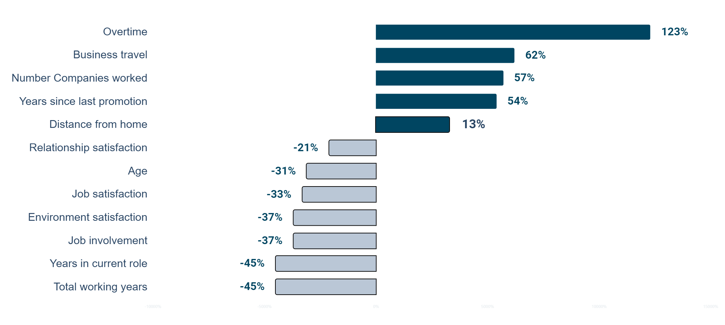








Predictive Model: Overtime has the largest impact on Attrition¹
Top 4 variables that increase the odds of attrition
Overtime
123%
The employees who do overtime have 123% more odds
Companies
Worked
57%
An increase of 1 company in curriculum is associated with a 57% increase
Business
Travel
62%
Going up from 1 level of traveling frequency to the next is associated with a 62% increase
Years since last promotion
54%
An increase of 1 year without being promoted is associated with a 54% increase
Top 4 variables that decrease the odds of attrition
Total working years
-45%
An increase of 1 year of work is associated with a 45% decrease
Job involvement
-37%
Going up from 1 level of involvement to the next is associated with a 37% decrease
Years in current role
-45%
An increase of 1 year in the current role is associated with a 45% decrease
Environment satisfaction
-37%
Going up from 1 level of satisfaction to the next is associated with a 37% decrease
Additionally: An increase of 1 km in commuting is associated with a 13% increase; Going up from 1 level of job satisfaction to the next is associated with a 33% decrease; An increase of 1 year in employees age is associated with a 31% decrease; Going up from 1 level of relationship satisfaction to the next is associated with a 21% decrease.
1. When interpreting the effect of a specific variable, all others are held constant at zero.

Slide 9
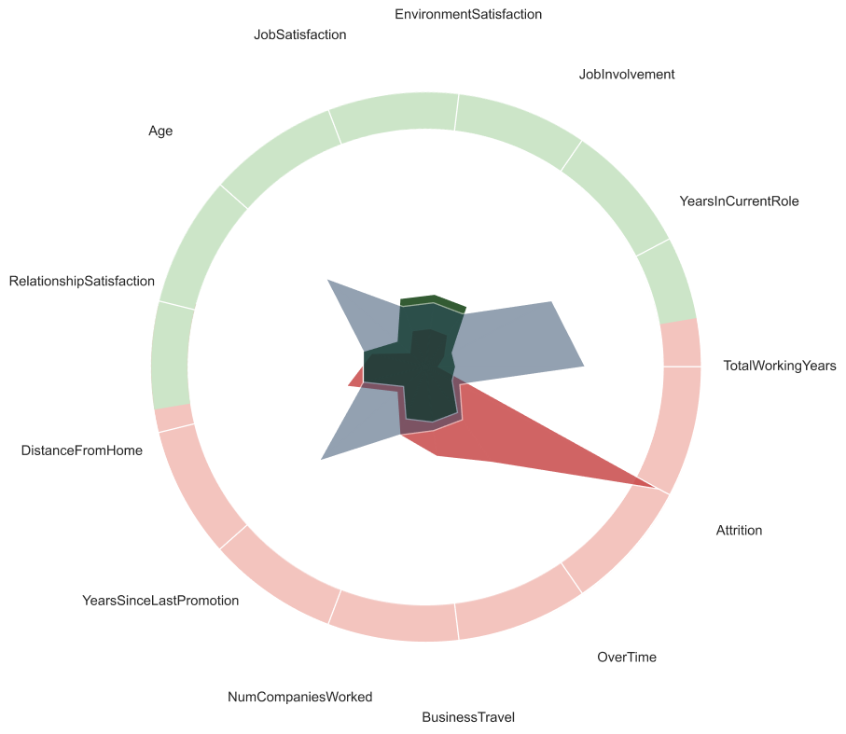

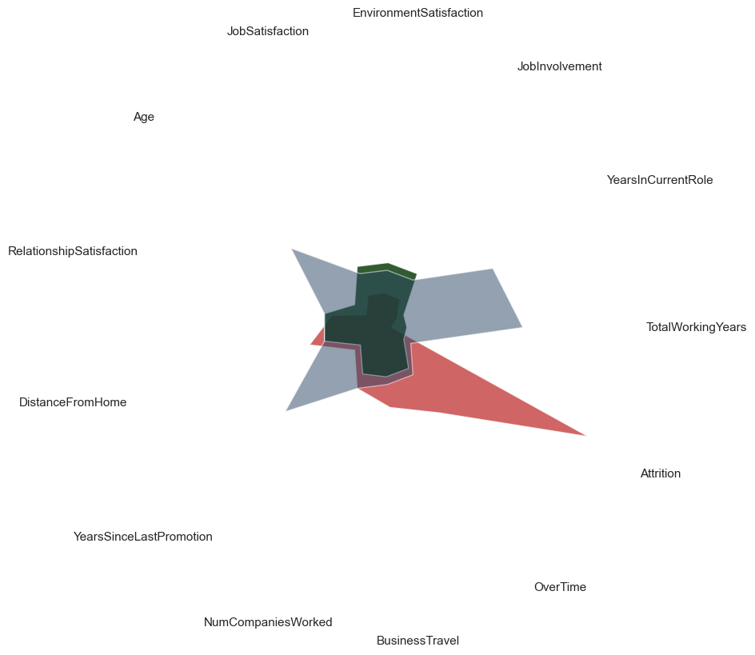
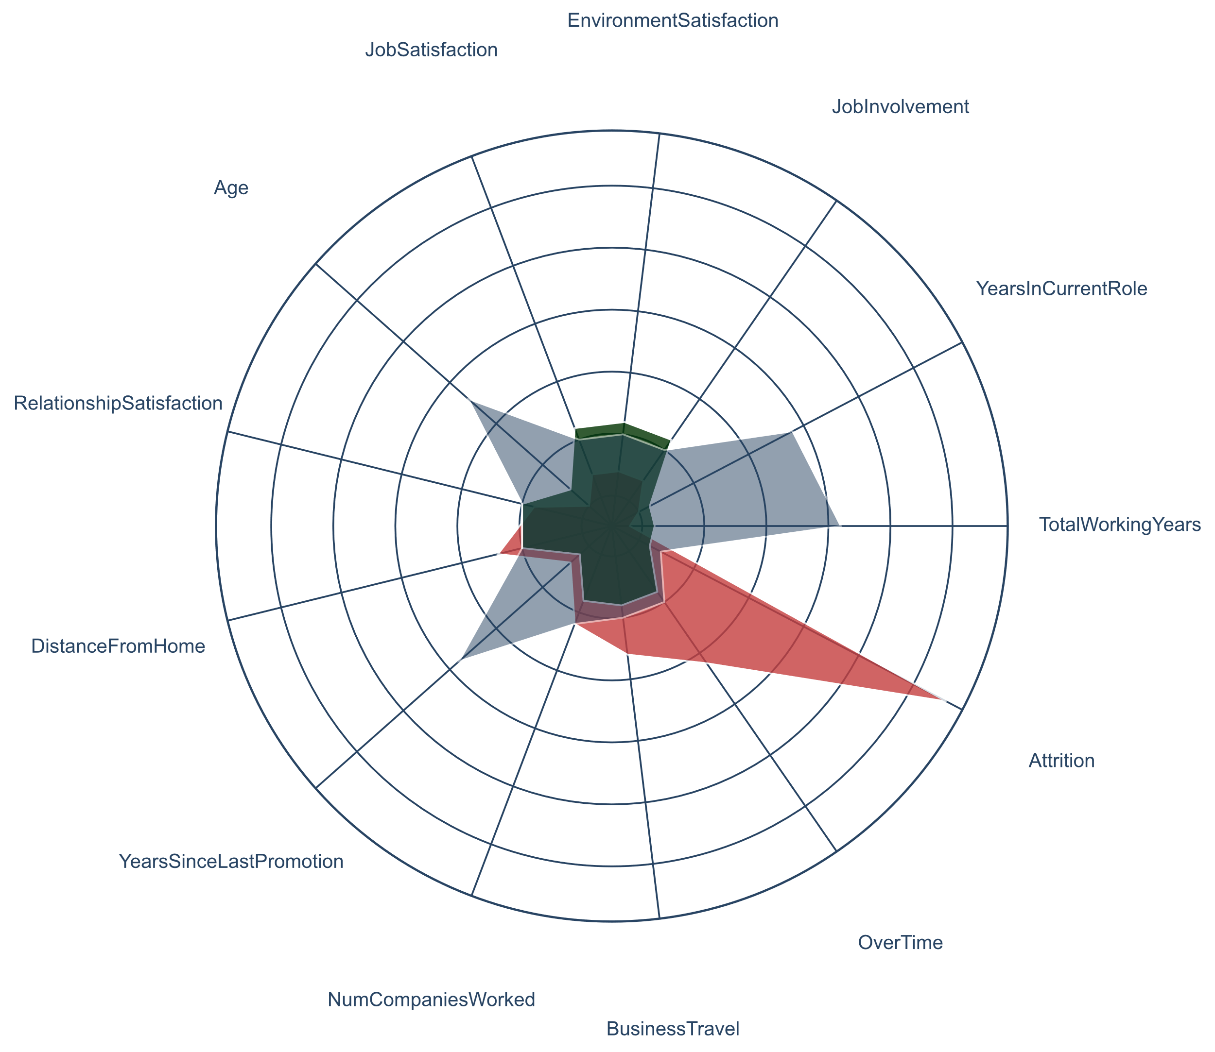
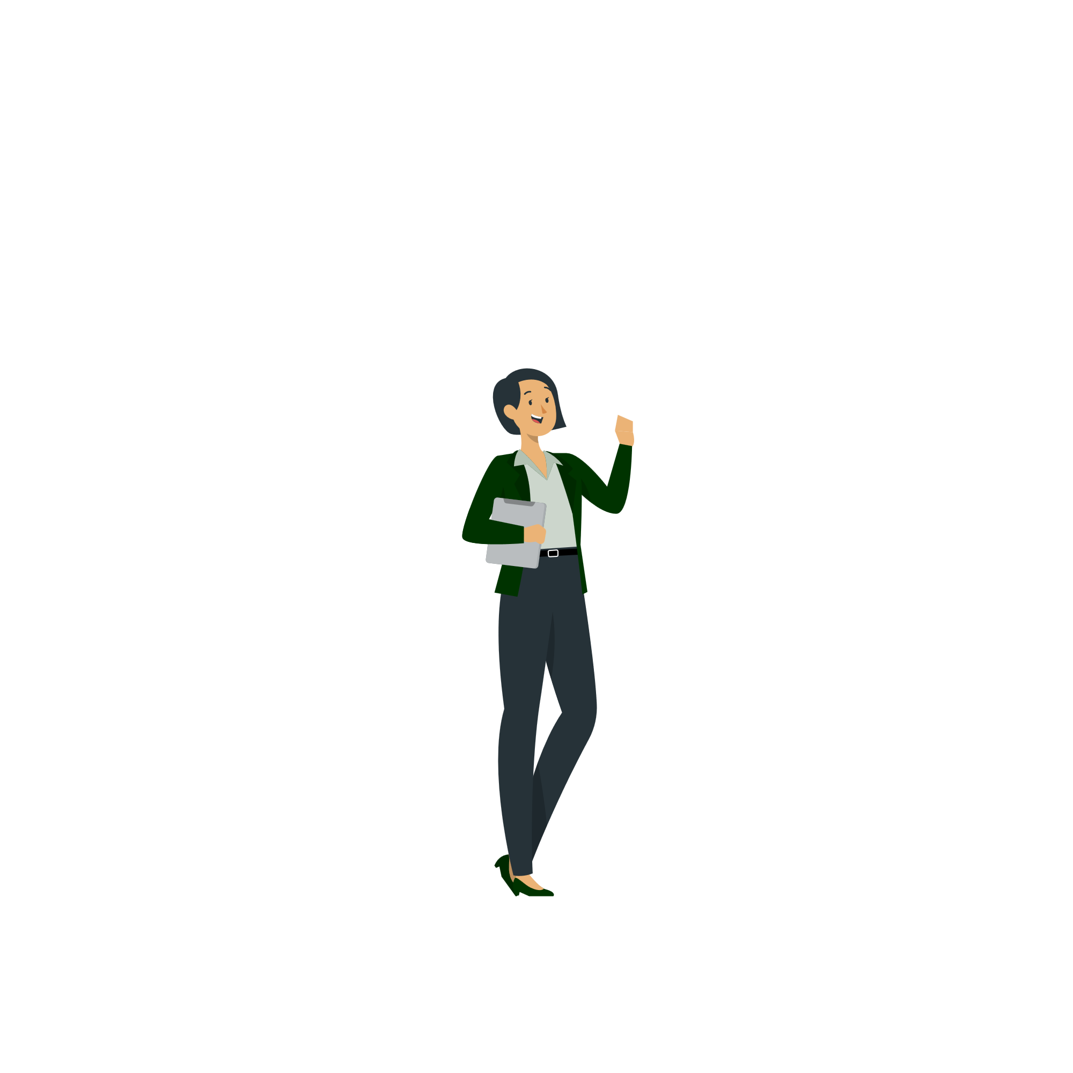

Employee Group Classification: Cluster 1 in need of immediate measures
Where’s the door?
219 employees
15% of total employees
100% Attrition within group
92% of company’s attrition
Young Go Getters
817 employees
56% of total employees
0% Attrition within group
0% of company’s attrition
Old but Gold
435 employees
30% of total employees
4% Attrition within group
8% of company’s attrition
Contribute to lower Attrition
Contribute to increase Attrition

Slide 10
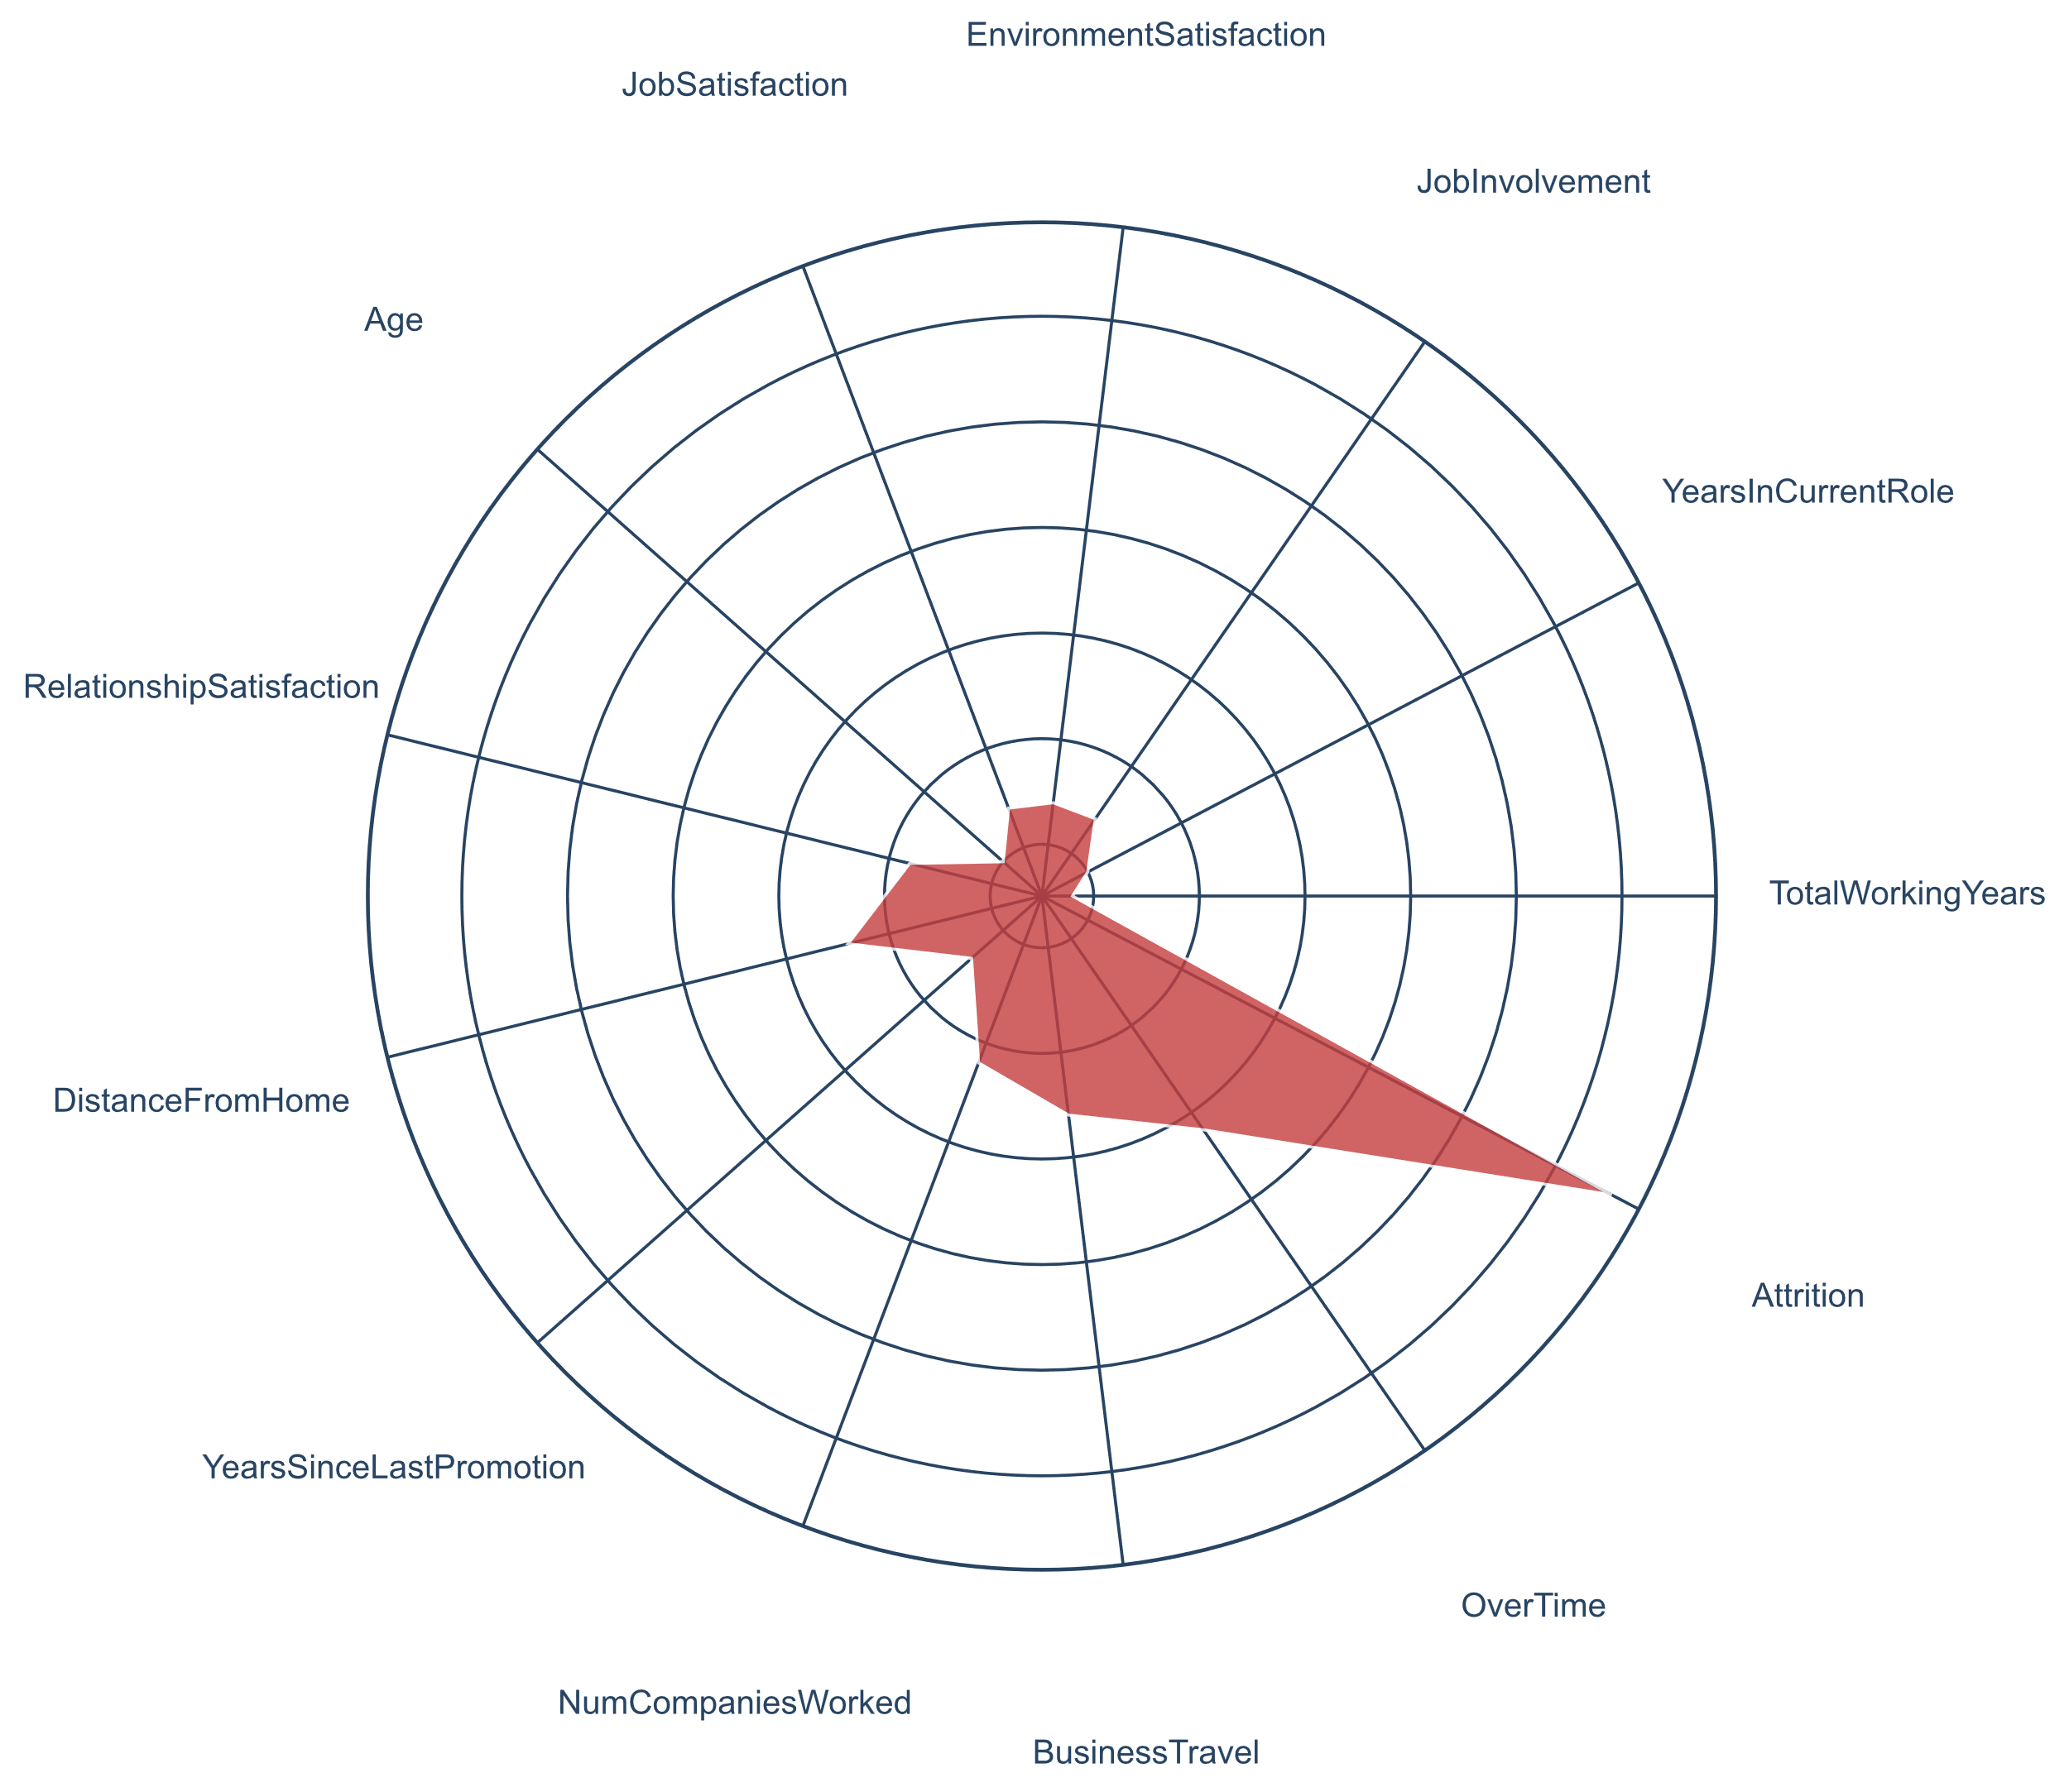
“Where’s the door?”: Company’s Attrition core
- All elements are leaving the company.
- Youngest group (32 years on average). Most elements have low-level jobs (87% on level 1 and 2) with low monthly income (50% of employees make up to 2.967€).
- Fairly new in the job market (7 years on average), most recent in the company (4 years on average) and brief occupation of current role (2 years on average).
- Lowest environment satisfaction, job satisfaction and lowest job involvement.
- Live further away from the company (11 km on average).
- Highest proportion of overtime (56%).
- Highest proportion of traveling (30% frequently and 65% rarely).
Contribute to lower Attrition
Contribute to increase Attrition

Slide 11
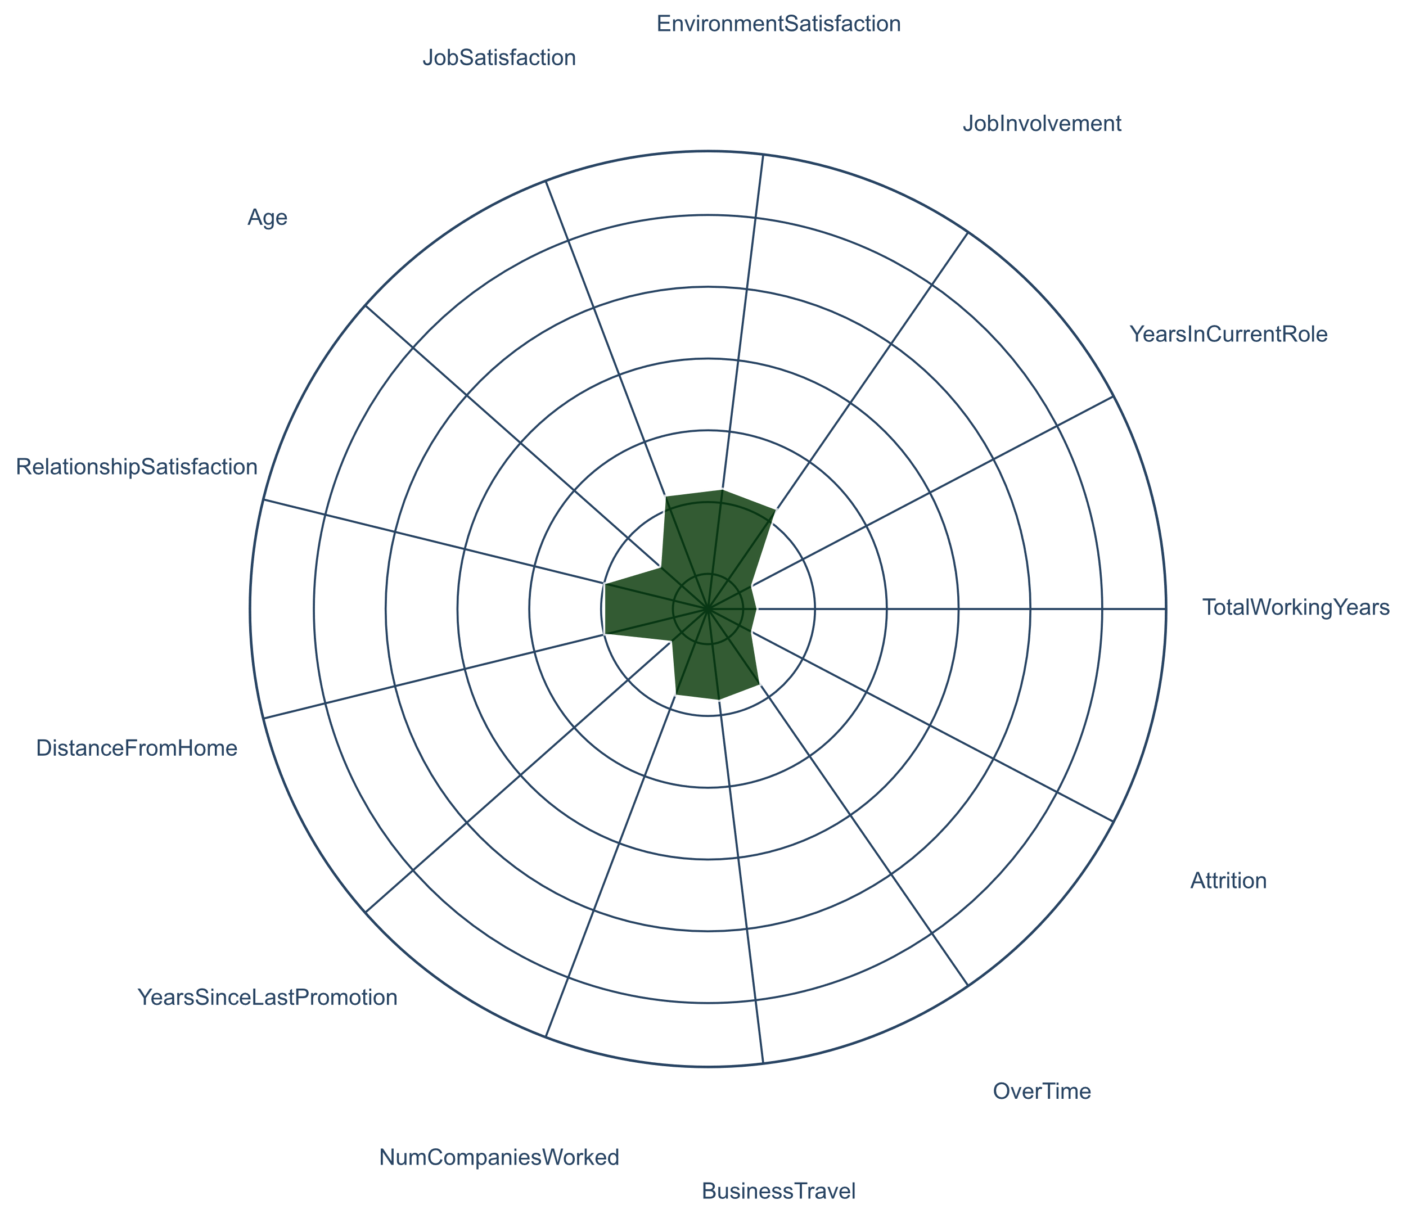
“Young Go Getters”: An example to follow
- None of the elements are leaving the company.
- Similar age (34 years on average) and low-level jobs proportion (88% on level 1 and 2). Higher monthly income, comparatively (50% of employees make up to 4.284€).
- Equally new in the job market (8 years on average), similar time in the company (5 years on average) and brief occupation of current role (3 years on average).
- Highest environment satisfaction, job satisfaction and highest job involvement.
-Live closer to the company (9 km on average).
-Low proportion of overtime (22%).
- Low proportion of traveling (16% frequently and 72% rarely).
Contribute to lower Attrition
Contribute to increase Attrition

Slide 12
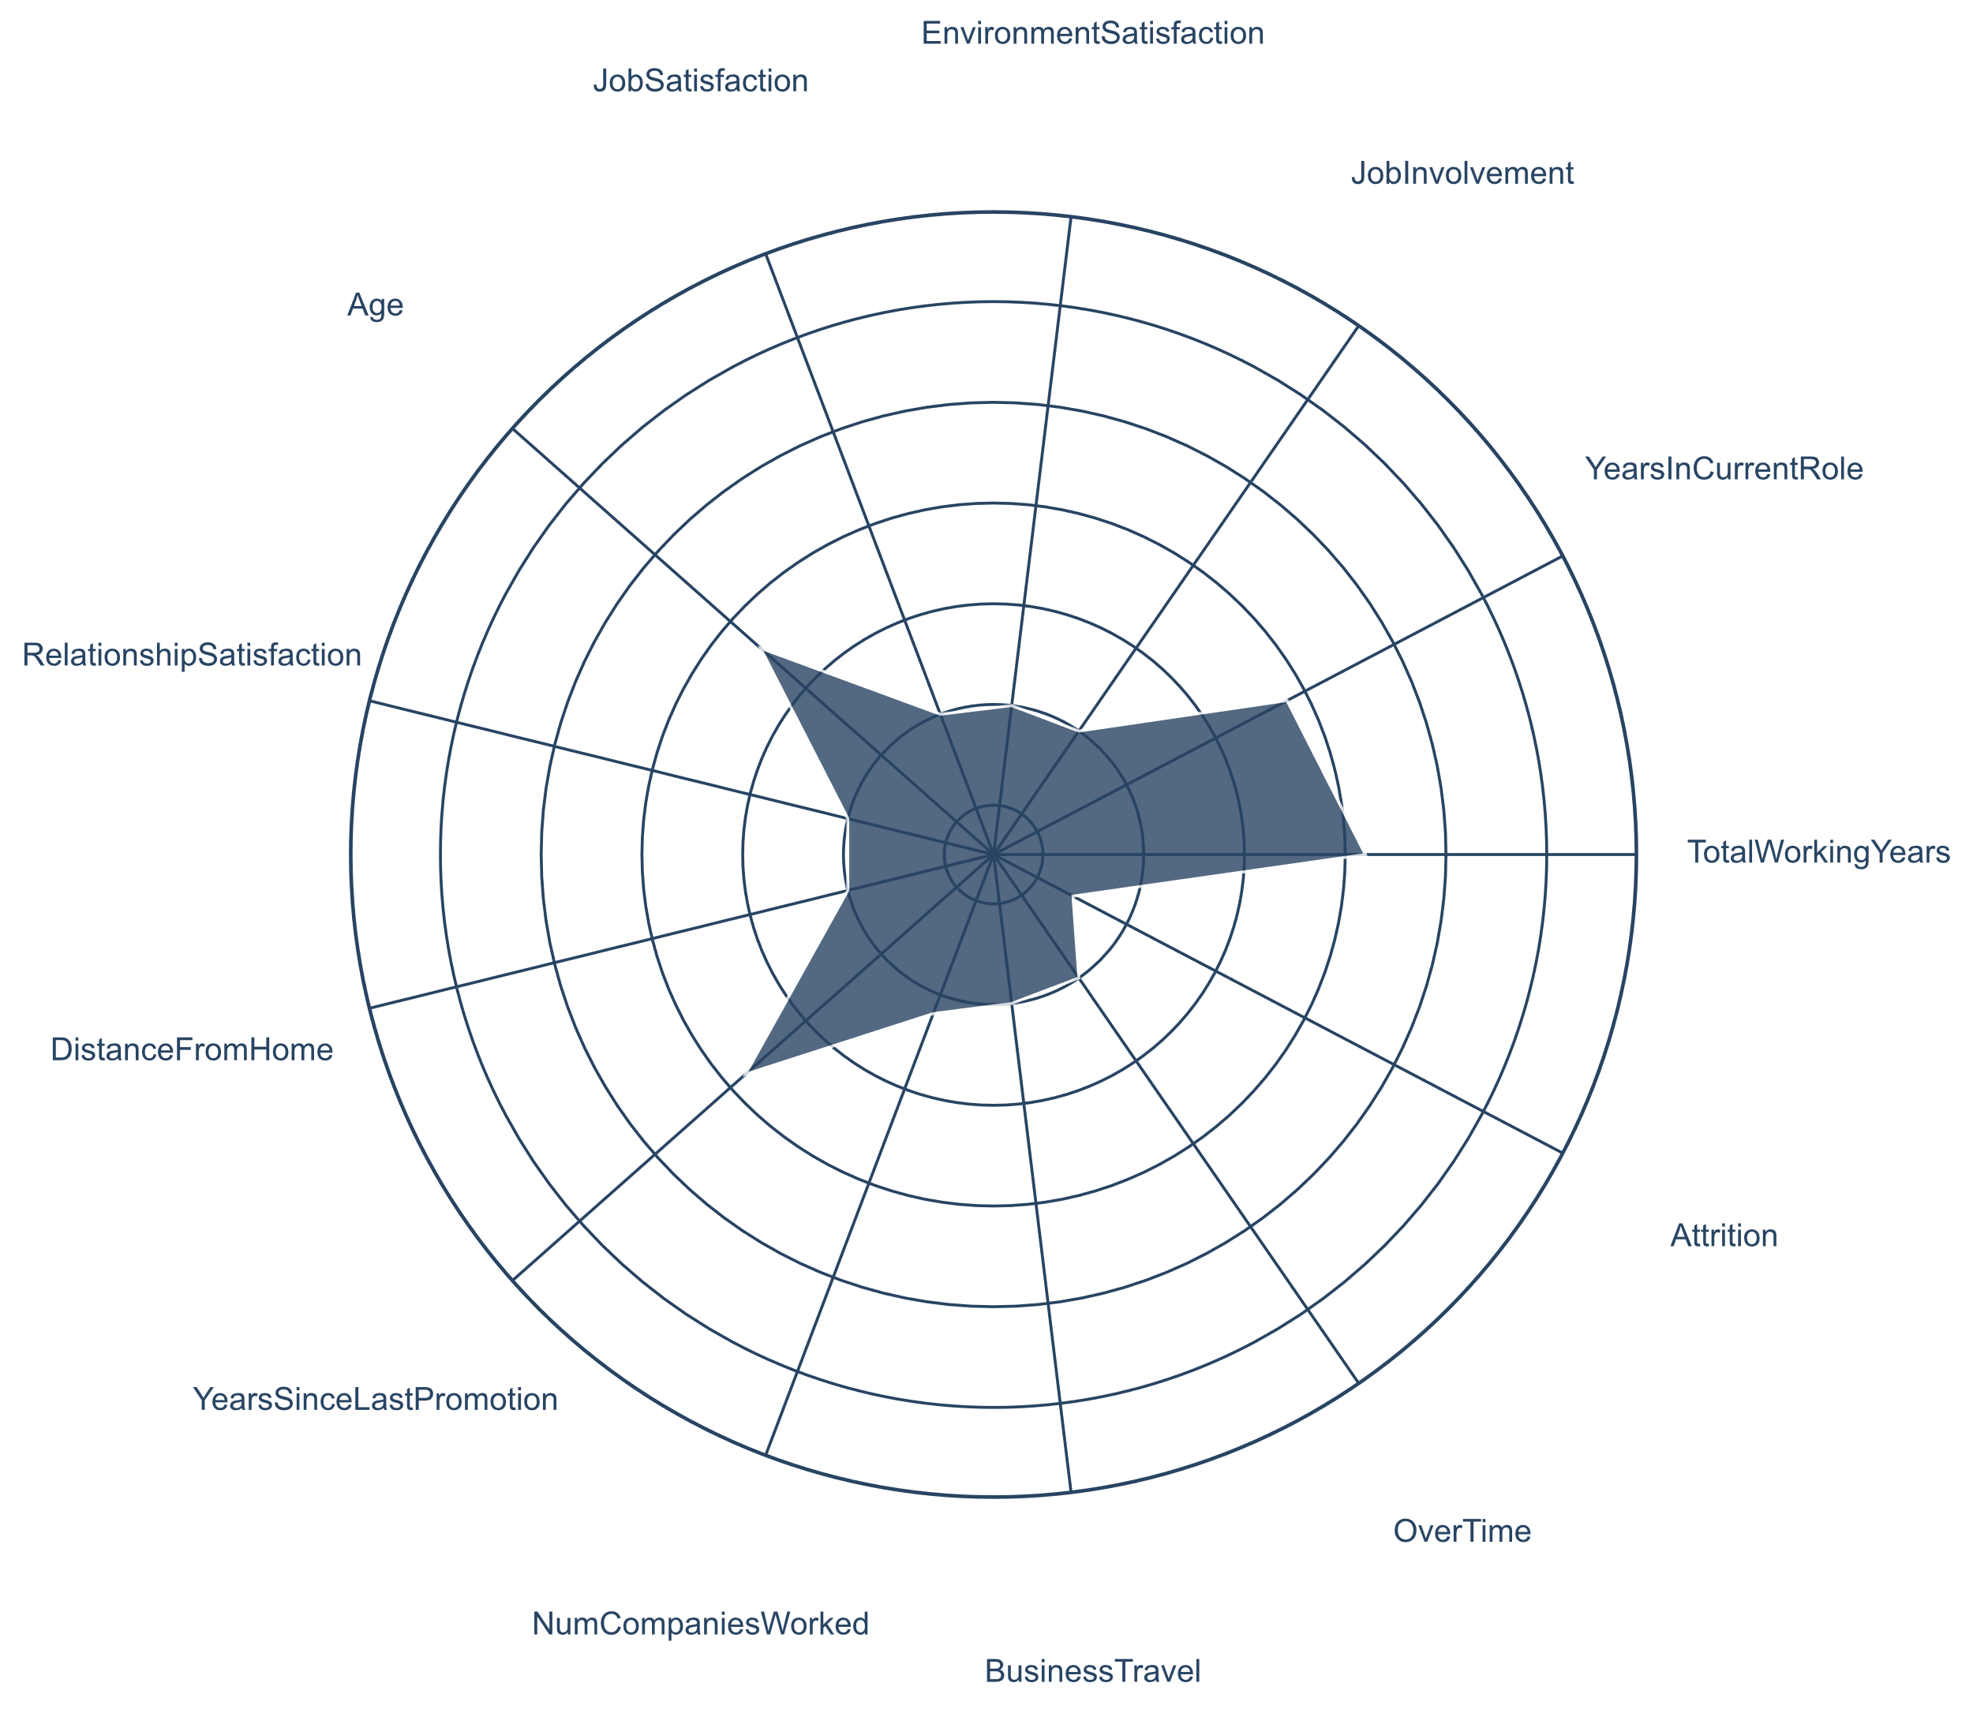
“Old but Gold”: Value senior employees
- 4% of the elements are leaving the company.
- Oldest group (44 years on average, higher concentration of employees between 50 and 60 years old). Many elements have high-level jobs (63% on level above 2) with high monthly income (50% of employees make up to 10.312€).
- Seasoned in the job market (20 years on average), oldest in the company (4 years on average) and longest occupation of current role (8 years on average).
- High environment satisfaction, job satisfaction and high job involvement.
- Live close to the company (9 km on average).
- Low proportion of overtime (27%).
- Low proportion of traveling (18% frequently and 71% rarely).
Contribute to lower Attrition
Contribute to increase Attrition
Notes:
This cluster contains many people near retirement (natural/expected o attrition)

Slide 13
Decreasing Employee Turnover: Minimize overtime, business travel and career stagnation
Overtime
Business Travel
Years since last Promotion
Our Insights
- 30% of the senior group have stayed on low level jobs (bellow level 3) for 8 years (on average) while being with the company for 11 years (on average).
- Performance Ratings assume only 2 values
-Proportion increases with environment satisfaction¹
- Less trained employees are more likely to work extra hours²
- Data lacks detail:
3 categories: Non, Frequently, Rarely
What can we do Now?
- Increase frequency of training sessions to improve efficiency
- Set an overtime maximum limit
- Quantify and identify the sources:
- Get clock in data
- Implement a time tracking solution
- Reduce unnecessary travel
- Review travel policies and offer support (travel reimbursement or time –off)
- Try to increase employee rotation
- Try to understand the lack of career progression with current manager (has been the same for the last 8 years)
- Create personalized development plans
What can be done in the Future?
- Analyze collected data:
-How many extra hours?
- Is overtime task dependent?
-What are the main causes:
Excessive workload?
Inefficient processes?
Resource allocation issues?
Undertrained employees?
- Set courses of action to tackle identified problems
- Improve current predictive model
- Quantify and describe:
- Get detailed data about travel frequency
- Conduct a survey to understand how to make travel more comfortable
- Analyze collected data:
- Is there a threshold?
- Extract insights to improve current travel policies
- Improve current predictive model
- Improve employee performance evaluation methods to acknowledge and reward best performance, productivity and experience.
- Improve transparent communication of promotion criteria
1. p = 0.0419; 2. p= 0.0014

Slide 14


Decreasing Employee Turnover: Facilitate commuting and decrease job hopping
Distance from Home
Number of Companies Worked
Attrition
Our Insights
- Although having the similar number of companies worked, on average, the “Where's the door?“ group worked for each company for 2 years and the “Old but Gold” group worked for 7 - suggesting a tendency to job hopping
- Although having the similar number of companies worked, on average, the “Where's the door?“ group worked for each company for 2 years and the “Old but Gold” group worked for 7 - suggesting a tendency to job hopping
-Important factor to keep in mid while recruiting – it can serve as a tiebreaker
What can we do Now?
- Offer commuter benefits:
Public transportation monthly pass subsidies
Parking
- Carpool assistance
- Investigate the possibility of Remote work
- Flexible schedules implementation
- Integrate the model in a solution that signals to the HR department, which employees are potentially leaving:
- Show identified variables
- Show group of employees and enable comparison to group average
- Enables elaboration of custom plan
- Show projected cost of quitting
- Offer industry competitive compensation and benefits
- Provide career and professional development opportunities
What can be done in the Future?
- Implement exit interviews:
- Understand motive
- Gather feedback
- Gather more records of employees who left to improve model training
- Analyze employee housing geographical distribution:
- Check if a shuttle service from the major residential area to the workplace is needed and viable

Slide 15

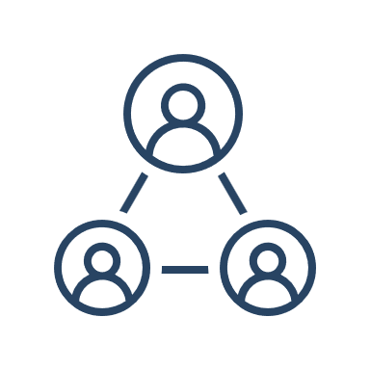
Optimizing Employee Retention: Foster Job involvement, relationship, environment and job satisfaction to reduce attrition
Job Involvement
Job Satisfaction
Enviornment Satisfaction
Relationship Satisfaction
- Involve employees in decision-making processes when appropriate.
- Give feedback on work-related issues and implement constructive suggestions.
- Keep employees informed about company goals, changes, and expectations.
- Provide opportunities for skill development and career advancement
- Acknowledge and reward employees for their hard work and achievements.
- Develop policies to enhance work life balance
- Promote a positive and inclusive workplace culture.
- Address and resolve conflicts promptly to maintain a harmonious environment.
- Offer wellness programs that focus on physical and mental health.
-Establish clear and open communication channels between leadership, management and employes.
-Organize team-building activities and events to strengthen interpersonal relationships among employees
Total working years in the company and years in the current role are the most important factors to the reduction of attrition.
This indicates that employees with stable careers have a smaller probability to leave the company, as shown by the Senior group.
The 4 topics discussed above are the key to create a company where employees want to stay and develop their skills and careers.

Slide 16
Take Home Message
- Our goal is to reduce attrition and save costs associated with turnover
- We created a Predictive model that identified overtime as the main factor contributing to attrition
- We identified 3 distinct groups of employees with different characteristics – one where all the employees are leaving the company, one that is flourishing and other composed by senior employees, some leaving for retirement.
- We explored what measures can be taken based on our insights, short and long term.
Some are policies, benefits that can be applied now to reduce attrition, others need more research to understand it’s causes and make data-based decisions.
- Additionally, we identified which factors contribute to employee retention, like job involvement and satisfaction.

